Slide 1











El Amplificador Operacional
$$v_{−}$$
-
$$A_{d}:$$
Ganancia en Modo Diferencial
$$v_{+}:$$
Entrada no inversora
$$v_{+}$$
+
$$v_{o}=A_{d}v_{d}$$
$$v_{d}=v_{+}−v_{−}$$
Voltaje en Modo Diferencial
$$v_{−}:$$
Entrada inversora
$$v_{−}$$
Amplificador diferencial
Amplificador de alta Ganancia
Amplificador de Salida
$$v_{o}$$
$$v_{+}$$
$$R_{offset}$$

Slide 2
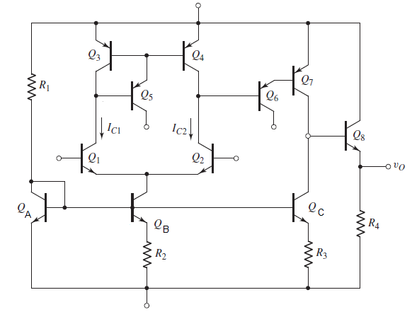





























$$V_{CC}$$
Amplificador diferencial
$$V_{EE}$$
$$V_{EE}$$
$$v_{−}$$
$$v_{+}$$
$$h_{ie3}$$
$$i_{b3}$$
$$i_{b4}$$
$$h_{ie4}$$
$${50i}_{b4}$$
$${50i}_{b3}$$
$$V_{CC}=10 V$$
$$V_{EE}$$
$$i_{b5}$$
$$h_{ie5}$$
$${50i}_{b5}$$
$$V_{EE}=−10 V$$
$$v_{−}$$
$$v_{+}$$
$$i_{b1}$$
$$h_{ie1}$$
$$i_{b2}$$
$$h_{ie2}$$
$$β_{NPN}=100$$
$${100i}_{b1}$$
$${100i}_{b2}$$
$$β_{PNP}=50$$
$$I_{o}={10}^{−14}A$$
$$R_{B}$$

Slide 3






















$$V_{CC}$$
$$V_{EE}$$
$$V_{EE}$$
$$v_{−}$$
$$v_{+}$$
$$V_{EE}$$
$$h_{ie3}$$
$$i_{b3}$$
$$i_{b4}$$
$$h_{ie4}$$
$$i_{b7}$$
$$h_{ie7}$$
$${50i}_{b7}$$
$${50i}_{b3}$$
$${50i}_{b4}$$
$$i_{b5}$$
$$h_{ie5}$$
$$i_{b6}$$
$$h_{ie6}$$
$$R_{C}$$
$${50i}_{b5}$$
$${50i}_{b6}$$
$$v_{−}$$
$$v_{+}$$
$$i_{b1}$$
$$h_{ie1}$$
$$i_{b2}$$
$$h_{ie2}$$
$${100i}_{b1}$$
$${100i}_{b2}$$
Amplificador de Alta Ganancia
Amplificador Diferencial
$$R_{B}$$

Slide 4





























$$V_{CC}$$
$$i_{b6}=i_{c2}−i_{c4}$$
$$i_{c2}=−i_{c1}=\frac{v_{d}}{5KΩ}$$
$$V_{EE}$$
$$V_{EE}$$
$$v_{o}=4.38x{10}^{6}v_{d}+\frac{v_{a}}{7.52}$$
$$i_{b6}=i_{c2}−i_{c3}$$
$$v_{−}$$
$$v_{+}$$
$$i_{b6}=i_{c2}−\frac{1275}{1276}i_{c1}$$
$$i_{b6}≈\frac{v_{d}}{2.5KΩ}$$
$$V_{EE}$$
$$i_{c3}$$
$$h_{ie3}$$
$$i_{b3}$$
$$i_{b4}$$
$$h_{ie4}$$
$$i_{b7}$$
$$h_{ie7}$$
$${50i}_{b7}$$
$$i_{c4}$$
$$R_{C}$$
$$i_{b8}$$
$$h_{ie8}$$
$$i_{b5}$$
$$h_{ie5}$$
$${50i}_{b5}$$
$$i_{b6}$$
$$h_{ie6}$$
$${100i}_{b8}$$
$${50i}_{b6}$$
$$v_{−}$$
$$v_{+}$$
$$i_{b1}$$
$$h_{ie1}$$
$$i_{b2}$$
$$h_{ie2}$$
$$i_{c1}$$
$$i_{c2}$$
$$v_{o}$$
$$R_{4}$$
Amplificador de Alta Ganancia
$$R_{B}$$
Amplificador
de Salida
Amplificador Diferencial

Slide 5
















$$i_{b7}$$
$$h_{ie7}$$
$${50i}_{b7}$$
$$i_{b7}$$
$$h_{ie7}$$
$${50i}_{b7}$$
$$v_{o}$$
$$i_{b6}≈\frac{v_{d}}{2.5KΩ}$$
$$R_{C}$$
$$i_{b8}$$
$$h_{ie8}$$
$$i_{b6}≈\frac{v_{d}}{2.5KΩ}$$
$${R^{′}}_{C}=?$$
$$h_{ie6}$$
$${100i}_{b8}$$
$$h_{ie6}$$
$${50i}_{b6}$$
$${50i}_{b6}$$
$$v_{o}$$
Amplificador de Alta Ganancia
$$R_{4}$$
Amplificador de Alta Ganancia
$$h_{ie7}=62.5 KΩ$$
$$R_{C}=35.5 MΩ$$
$$h_{ie6}≈3 MΩ$$
Amplificador
de Salida
$$R_{4}=50 KΩ$$
$$h_{ie8}=12.5 KΩ$$

Slide 6



$$i_{b7}$$
$$h_{ie7}$$
$${50i}_{b7}$$
$$v_{o}$$
$$i_{b6}≈\frac{v_{d}}{2.5KΩ}$$
$${R^{′}}_{C}$$
$$h_{ie6}$$
$${50i}_{b6}$$
Amplificador de Alta Ganancia
$${R^{′}}_{C}=4.38 MΩ$$
$$h_{ie7}=62.5 KΩ$$
$$h_{ie6}≈3 MΩ$$

Slide 7

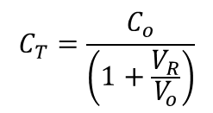



Capacitancia del diodo
Polarización en Contra
Capacitancia del diodo debido a la Zona de Agotamiento o Transición :
C_{T}
d_{o}
$$A (Área Transversal)$$
p
$$C_{T}=\frac{C_{o}}{\left(1+\frac{V_{R}}{V_{o}}\right)}$$
n
-
+
-
-
-
-
-
+
-
+
$$C_{o}=\frac{εA}{d_{o}}$$
$$V_{o}=\frac{N_{D}q}{ε}\frac{{d_{o}}^{2}}{4}$$
$$N_{D}: Concentración de$$
$$portadores mayoritarios$$
V_{R}
$$d_{o}: Distancia de la zona de agotamiento o transición cuando V_{R}=0V$$

Slide 8



Capacitancia del diodo
Polarización a Favor
Capacitancia del diodo debido al proceso de Difusión :
$$C_{D}≫C_{T}$$
$$I_{D}$$
p
$$C_{D}=τ\frac{I_{D}}{V_{T}}$$
n
-
+
-
-
-
-
-
+
+
-
V_{F}
$$τ: Tiempo promedio de recombinación de los pares electrón−hueco$$

Slide 9


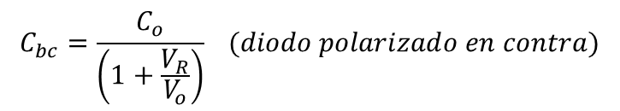











Respuesta en alta frecuencia del transistor Bipolar
$$C_{bc}$$
$$C_{bc}=\frac{C_{o}}{\left(1+\frac{V_{R}}{V_{o}}\right)} (diodo polarizado en contra)$$
b
c
NPN
$$V_{o}=\frac{N_{D}q}{ε}\frac{{d_{o}}^{2}}{4}$$
$$h_{ie}$$
$${h_{fe}i}_{b}$$
$$C_{o}=\frac{εA}{d_{o}}$$
$$C_{be}$$
$$i_{b}$$
e
$$C_{be}=τ\frac{I_{D}}{V_{T}} (diodo polarizado a favor)$$
e
$$C_{be}≫C_{bc}$$
$$C_{be}$$
$$h_{ie}$$
$${h_{fe}i}_{b}$$
PNP
$$i_{b}$$
b
c
$$C_{bc}$$

Slide 10













Amplificador de Alta Ganancia
$$C_{be}$$
$$i_{b7}$$
$$h_{ie7}$$
$${50i}_{b7}$$
$$C_{bc}$$
$$v_{o}$$
$$i_{b6}≈\frac{v_{d}}{2.5KΩ}$$
$${R^{′}}_{C}$$
$$h_{ie6}$$
$${50i}_{b6}$$
$$C_{bc}$$
$$v_{o}$$
$${R^{′}}_{C}=4.38 MΩ$$
$$i_{b6}≈\frac{v_{d}}{2.5KΩ}$$
$$h_{ie6}$$
$${50i}_{b6}$$
$$C_{be}$$
$$h_{ie7}$$
$${50i}_{b7}$$
$${R^{′}}_{C}$$
$$h_{ie7}=62.5 KΩ$$
$$i_{b7}$$
$$h_{ie6}≈3 MΩ$$

Slide 11
Amplificador de Alta Ganancia
$$C_{bc}$$
$$v_{o}$$
$${R^{′}}_{C}=4.38 MΩ$$
$$i_{b6}≈\frac{v_{d}}{2.5KΩ}$$
$$h_{ie6}$$
$${50i}_{b6}$$
$$C_{be}$$
$$h_{ie7}$$
$${50i}_{b7}$$
$${R^{′}}_{C}$$
$$h_{ie7}=62.5 KΩ$$
$$i_{b7}$$
$$h_{ie6}≈3 MΩ$$

Slide 12

Teorema de Miller:
+
+
V1
V2
-
-
+
+
+
+
V1
-
V2
V1
-
V2
-
-
$$C_{bc}$$
$$v_{b7}$$
$${R^{′}}_{C}=4.38 MΩ$$
$$v_{o}$$
$$i_{b6}≈\frac{v_{d}}{2.5KΩ}$$
$$h_{ie6}$$
$${50i}_{b6}$$
$$C_{be}$$
$$h_{ie7}$$
$${50i}_{b7}$$
$${R^{′}}_{C}$$
$$h_{ie7}=62.5 KΩ$$
$$i_{b7}$$
$$h_{ie6}≈3 MΩ$$

Slide 13





Teorema de Miller:
+
+
Z
V2
V1
-
-
Z
+
+
+
+
V1
-
V2
V1
-
V2
-
-
$$C_{bc}$$
$$C_{bc}$$
$$v_{b7}$$
$${R^{′}}_{C}=4.38 MΩ$$
$$v_{o}$$
$$i_{b6}≈\frac{v_{d}}{2.5KΩ}$$
+
$$h_{ie6}$$
$${50i}_{b6}$$
$$C_{be}$$
$$h_{ie7}$$
+
$$v_{o}$$
$$v_{b7}$$
$${50i}_{b7}$$
$${R^{′}}_{C}$$
$$h_{ie7}=62.5 KΩ$$
-
-
$$i_{b7}$$
$$h_{ie6}≈3 MΩ$$

Slide 14




Teorema de Miller:
+
+
Z
V2
V1
-
-
Z
+
+
+
V2
V1
Z
V2
V1
-
Z
$${50i}_{b7}≫jωC_{bc}v_{b7}$$
-
-
$$\frac{1}{jωC_{bc}}≫{R^{′}}_{C}$$
$$C_{bc}$$
$$\frac{1}{jωC_{bc}}$$
$$v_{b7}$$
$${R^{′}}_{C}=4.38 MΩ$$
$$v_{o}$$
$$i_{b6}≈\frac{v_{d}}{2.5KΩ}$$
$$h_{ie6}$$
$${50i}_{b6}$$
$$C_{be}$$
$$h_{ie7}$$
+
$$v_{o}$$
$${50i}_{b7}$$
$${R^{′}}_{C}$$
$$h_{ie7}=62.5 KΩ$$
$$i_{b7}$$
-
$$jωC_{bc}v_{b7}$$
$$h_{ie6}≈3 MΩ$$

Slide 15



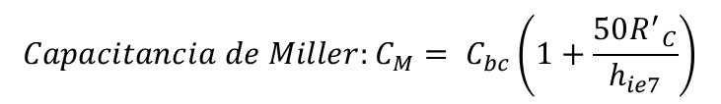

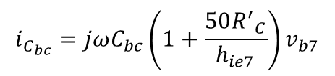
$$Capacitancia de Miller:C_{M}= C_{bc}\left(1+\frac{50{R^{′}}_{C}}{h_{ie7}}\right)$$
$$i_{C_{bc}}=jωC_{M}v_{b7}$$
$$i_{C_{bc}}=jωC_{bc}\left(v_{b7}−v_{o}\right)=jωC_{bc}\left(v_{b7}−{50{R^{′}}_{C}i}_{b7}\right)$$
$$i_{C_{bc}}=jωC_{bc}\left(1+\frac{50{R^{′}}_{C}}{h_{ie7}}\right)v_{b7}$$
$$i_{b7}=−\frac{v_{b7}}{h_{ie7}}$$
$$i_{C_{bc}}$$
$$C_{bc}$$
$$v_{b7}$$
$${R^{′}}_{C}=4.38 MΩ$$
$$v_{o}$$
$$i_{b6}≈\frac{v_{d}}{2.5KΩ}$$
$$h_{ie6}$$
$${50i}_{b6}$$
$$C_{be}$$
$$h_{ie7}$$
+
$$v_{o}$$
$$={50{R^{′}}_{C}i}_{b7}$$
$${50i}_{b7}$$
$${R^{′}}_{C}$$
$$h_{ie7}=62.5 KΩ$$
$$i_{b7}$$
-
$$h_{ie6}≈3 MΩ$$

Slide 16
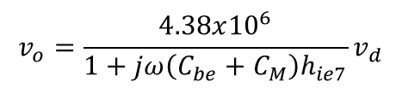

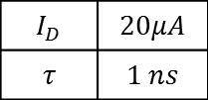
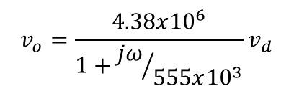




$$Capacitancia de Miller:C_{M}= C_{bc}\left(1+\frac{50{R^{′}}_{C}}{h_{ie7}}\right)$$
$$i_{C_{bc}}=jωC_{M}v_{b7}$$
$$C_{be}=τ\frac{I_{D}}{V_{T}} (diodo polarizado a favor)$$
$$I_{D}$$ | $$20μA$$
$$τ$$ | $$1 ns$$
$$C_{be}=0.8 pF$$
$$v_{o}=\frac{4.38x{10}^{6}}{1+jω\left(C_{be}+C_{M}\right)h_{ie7}}v_{d}$$
$$C_{be}≫C_{bc}$$
$$C_{bc}=8x{10}^{−3} pF$$
$$v_{o}=\frac{4.38x{10}^{6}}{1+{jω}/{555x{10}^{3}}}v_{d}$$
$$i_{C_{bc}}$$
$$C_{M}$$
$$v_{b7}$$
$${R^{′}}_{C}=4.38 MΩ$$
$$v_{o}$$
$$i_{b6}≈\frac{v_{d}}{2.5KΩ}$$
$$h_{ie6}$$
$${50i}_{b6}$$
$$C_{be}$$
$$h_{ie7}$$
$${50i}_{b7}$$
$${R^{′}}_{C}$$
$$h_{ie7}=62.5 KΩ$$
$$i_{b7}$$
$$h_{ie6}≈3 MΩ$$

Slide 17
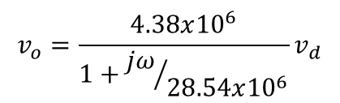
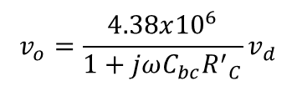
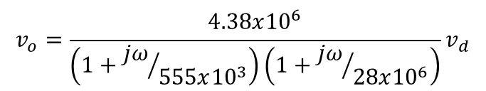


$$v_{o}=\frac{4.38x{10}^{6}}{\left(1+{jω}/{555x{10}^{3}}\right)\left(1+{jω}/{28x{10}^{6}}\right)}v_{d}$$
$${50i}_{b7}≫jωC_{bc}v_{b7}$$
$$v_{o}=\frac{4.38x{10}^{6}}{1+jωC_{bc}{R^{′}}_{C}}v_{d}$$
$$v_{o}=\frac{4.38x{10}^{6}}{1+{jω}/{28.54x{10}^{6}}}v_{d}$$
$$C_{bc}=8x{10}^{−3} pF$$
$$C_{bc}$$
$$v_{b7}$$
$${R^{′}}_{C}=4.38 MΩ$$
$$v_{o}$$
$$i_{b6}≈\frac{v_{d}}{2.5KΩ}$$
$$h_{ie6}$$
$${50i}_{b6}$$
$$C_{be}$$
$$h_{ie7}$$
+
$$v_{o}$$
$$C_{bc}$$
$${50i}_{b7}$$
$${R^{′}}_{C}$$
$$h_{ie7}=62.5 KΩ$$
$$i_{b7}$$
-
$$jωC_{bc}v_{b7}$$
$$h_{ie6}≈3 MΩ$$

Slide 18







$$C_{be7}+C_{M7}$$
$$i_{b7}$$
$$h_{ie7}$$
$${50i}_{b7}$$
$$\lim_{ω→∞}{\frac{1}{jω\left(C_{be7}+C_{M7}\right)}=0}$$
$$v_{o}$$
$$i_{b6}≈\frac{v_{d}}{2.5KΩ}$$
$${R^{′}}_{C}$$
$$h_{ie6}$$
$${50i}_{b6}$$
$$i_{b6}$$
Amplificador de Alta Ganancia
$${R^{′}}_{C}=4.38 MΩ$$
$$h_{ie7}=62.5 KΩ$$
$$i_{i}≈\frac{v_{d}}{2.5KΩ}$$
$$C_{be6}$$
$$i_{b6}$$
$$h_{ie6}≈3 MΩ$$
$$h_{ie6}$$
$${50i}_{b6}$$
$$C_{bc6}$$

Slide 19


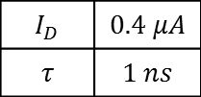
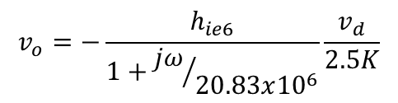

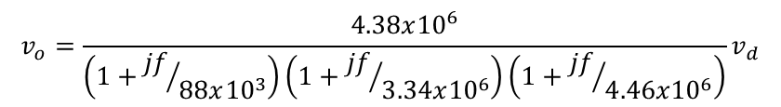
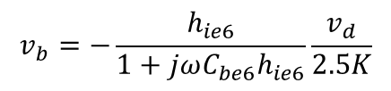

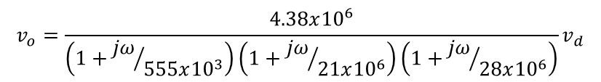
$$v_{o}=\frac{4.38x{10}^{6}}{\left(1+{jω}/{555x{10}^{3}}\right)\left(1+{jω}/{21x{10}^{6}}\right)\left(1+{jω}/{28x{10}^{6}}\right)}v_{d}$$
$$C_{be}≫C_{bc}$$
$$v_{o}=\frac{4.38x{10}^{6}}{\left(1+{jf}/{88x{10}^{3}}\right)\left(1+{jf}/{3.34x{10}^{6}}\right)\left(1+{jf}/{4.46x{10}^{6}}\right)}v_{d}$$
$$C_{be}=τ\frac{I_{D}}{V_{T}} (diodo polarizado a favor)$$
$$I_{D}$$ | $$0.4 μA$$
$$τ$$ | $$1 ns$$
$$C_{be6}=0.016 pF$$
$$i_{i}≈\frac{v_{d}}{2.5KΩ}$$
$$C_{be6}$$
$$v_{b}$$
$$i_{b6}$$
$$h_{ie6}≈3 MΩ$$
$$h_{ie6}$$
$$v_{b}=−\frac{h_{ie6}}{1+jωC_{be6}h_{ie6}}\frac{v_{d}}{2.5K}$$
$$i_{i}≈\frac{v_{d}}{2.5KΩ}$$
$$C_{be6}$$
$$i_{b6}$$
$$v_{o}=−\frac{h_{ie6}}{1+{jω}/{20.83x{10}^{6}}}\frac{v_{d}}{2.5K}$$
$${50i}_{b6}$$
$$h_{ie6}$$
$$C_{bc6}$$

Slide 20
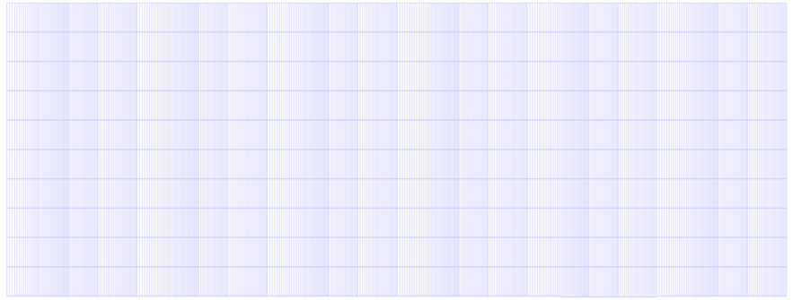
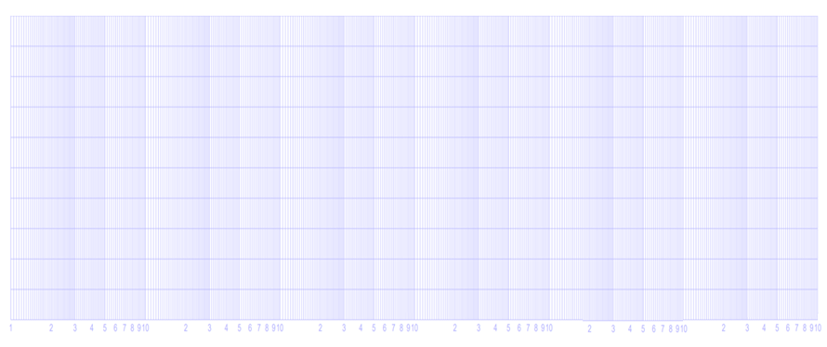








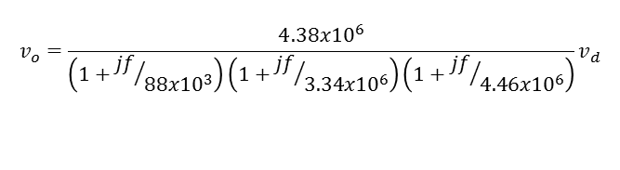















$$v_{o}=\frac{4.38x{10}^{6}}{\left(1+{jf}/{88x{10}^{3}}\right)\left(1+{jf}/{3.34x{10}^{6}}\right)\left(1+{jf}/{4.46x{10}^{6}}\right)}v_{d}$$
$$120$$
$$−20 dB/decada$$
$$80$$
$$−40 dB/decada$$
Magnitud
$$40$$
$$−60 dB/decada$$
$$0$$
Respuesta en Frecuencia (Diagramas de Bode)
$$MHz$$
$$−40$$
$$0.01$$
$$0.1$$
$$1$$
$$10$$
$$100$$
$$−45°$$
-$45°/decada$
Fase
$$−90°$$
-$90°/decada$
-$135°/decada$
$$−135°$$
$$−180°$$
-$90°/decada$
$$−225°$$

Slide 21
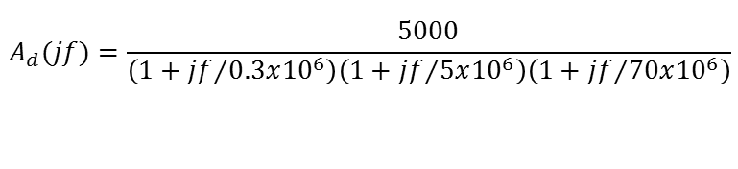

$$A_{d}{(jf)}=\frac{5000}{\left(1+{jf}/{0.3x{10}^{6}}\right)\left(1+{jf}/{5x{10}^{6}}\right)\left(1+{jf}/{70x{10}^{6}}\right)}$$
Práctica
El LH0024 posee la respuesta en frecuencia mostrada. Grafique el diagrama de Bode de Magnitud y Fase
$$120$$
$$80$$
$$40$$
$$0$$
Respuesta en Frecuencia (Diagramas de Bode)
Magnitud
$$−40$$
$$0.01$$
$$0.1$$
$$1$$
$$10$$
$$100$$
$$MHz$$
$$−45°$$
$$−90°$$
$$−135°$$
$$−180°$$
Fase
$$−225°$$

